Slide 1
INF1002 Programming Fundamentals (AY2025-T1)
C – Lab4
14-Nov-2025 (Week 11)

Slide 2
INF1002 – Programming Fundamentals
Warmup Lab4:
EXE_1: USER-DEFINED DATA TYPES
EXE_2: LINKED LISTS
Not required to submit.
Practice for quiz.
Gradescope Lab4 Task:
insertion sort
Gradescope Submission due
Thursday, 20-Nov-2025 23:59:00

Slide 3
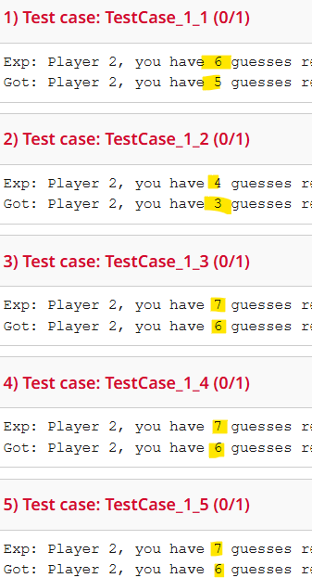
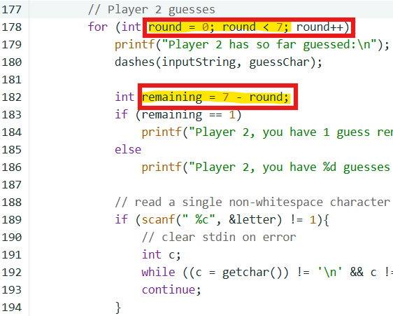
INF1002 – Programming Fundamentals
C Lab3 Feedback - A
Count offset!
Hardcoded variable: ‘round’!

Slide 4
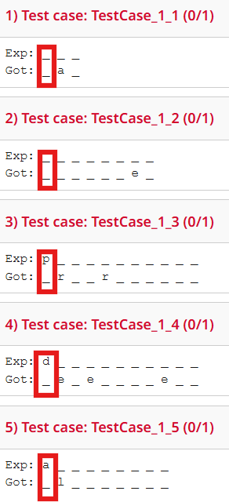
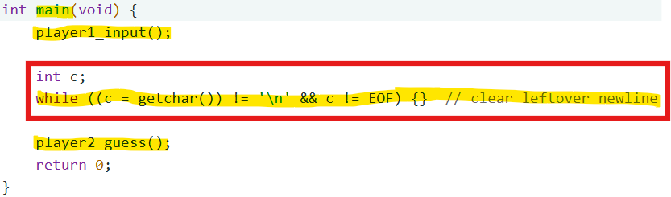
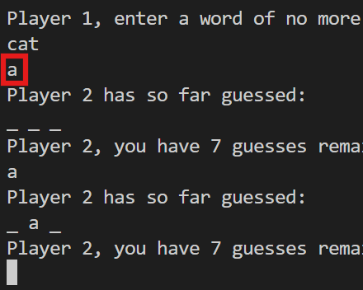
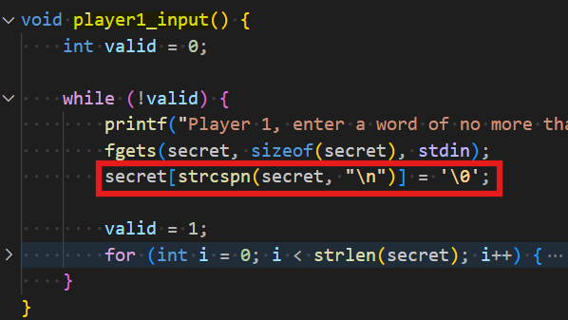
INF1002 – Programming Fundamentals
C Lab3 Feedback - B
Unnecessary!

Slide 5
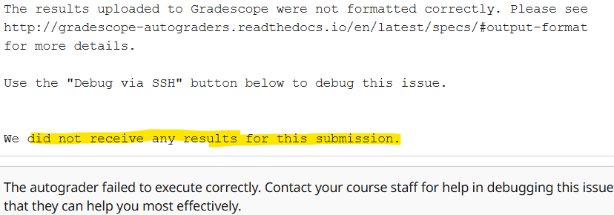
INF1002 – Programming Fundamentals
C Lab3 Feedback - C
Rerun
autograder
1 of 3
Endless loop?
Timeout?
Connection closed?

Slide 6
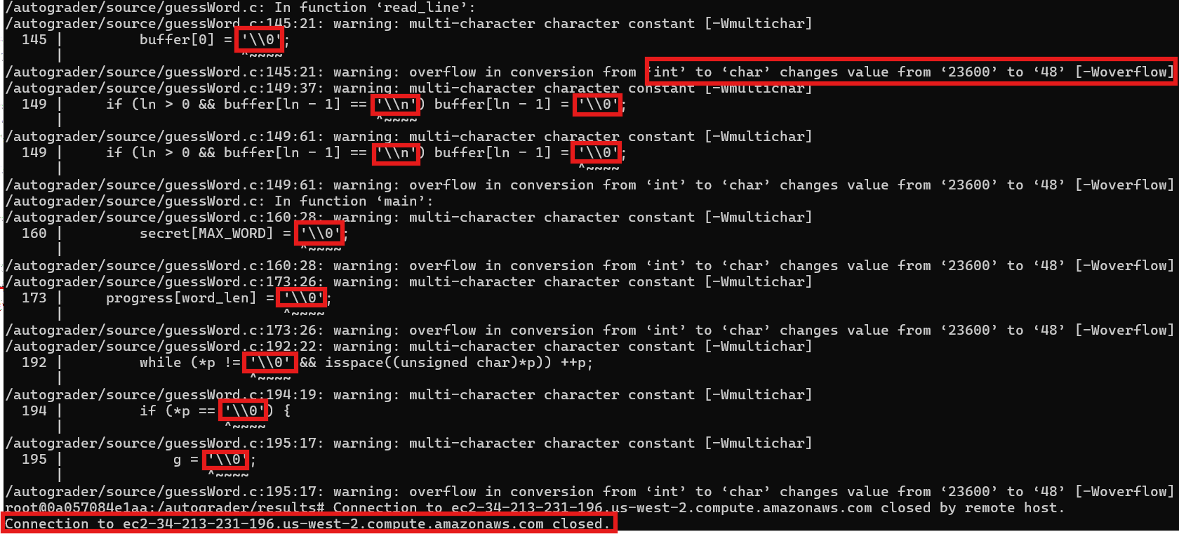
INF1002 – Programming Fundamentals
C Lab3 Feedback - C
2 of 3
Multi-char char const: ‘\\0’ and ‘\\n’!
Trying to escape: ‘\0’ and ‘\n’?

Slide 7
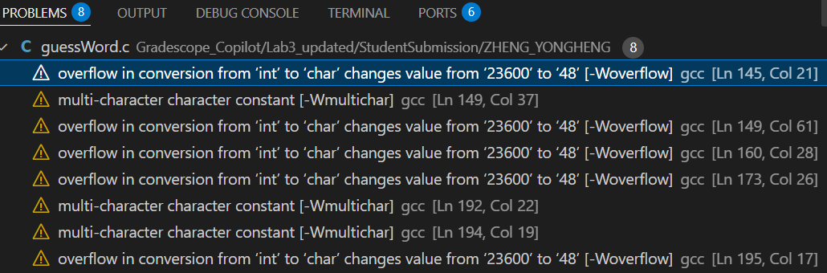
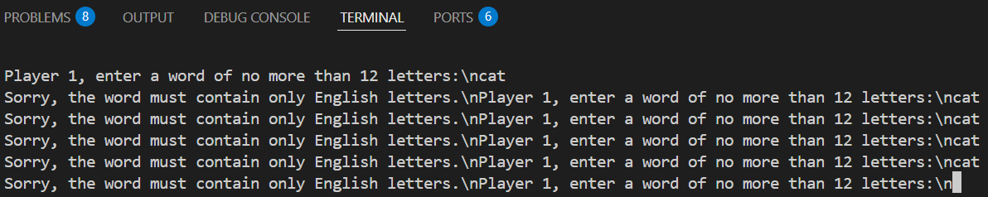
INF1002 – Programming Fundamentals
C Lab3 Feedback - C
Compiler warnings!
3 of 3
Endless loop!
Timeout!

Slide 8
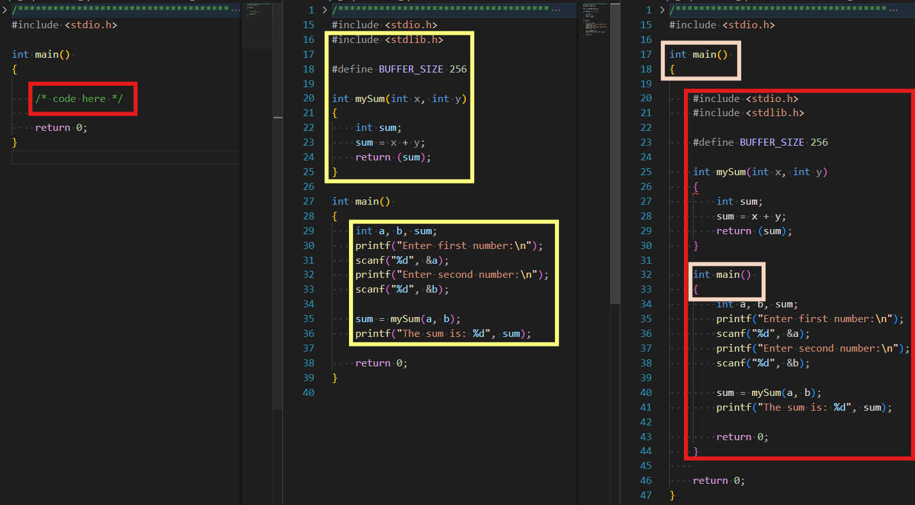


INF1002 – Programming Fundamentals
C Lab3 Feedback
main() in main()!

Slide 9
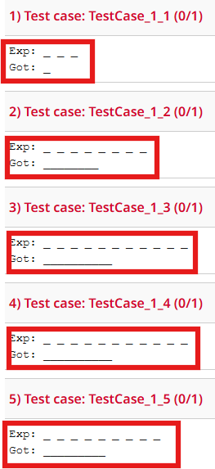
INF1002 – Programming Fundamentals
C Lab3 Feedback
Obviously, missing spaces between characters!

Slide 10
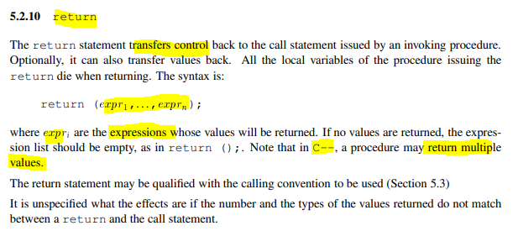
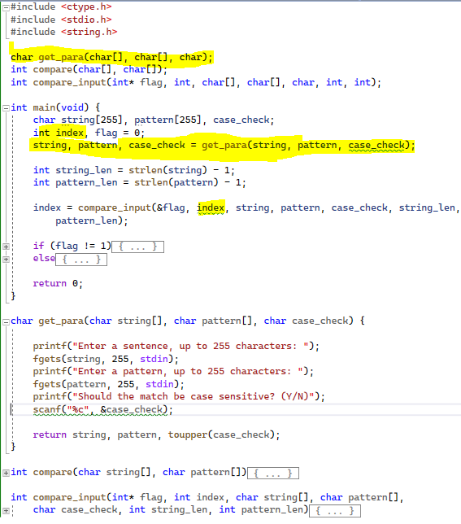
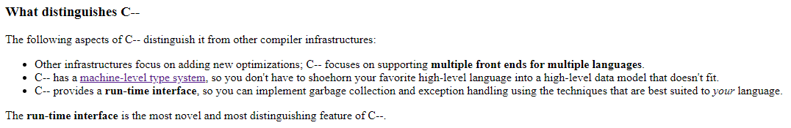
INF1002 – Programming Fundamentals
return
https://www.microsoft.com/en-us/research/wp-content/uploads/1998/01/pal-manual.pdf
https://www.cs.tufts.edu/~nr/c--/index.html
Family of C:
C--, C, C++, C#, Turbo-C++, Watcom-C, Tiny-C, Intel-C++, GNU-C, MinGW-C, Clang, …

Slide 11
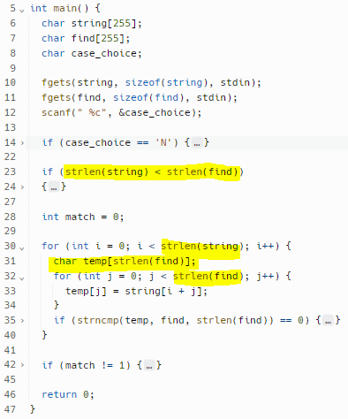
INF1002 – Programming Fundamentals
Arrays: Compile-time / Run-time
1. Time complexity
The “strlen()” function has a time complexity of O(n), where n is the length of the input string.
Since the loop runs n times, the total time complexity of the loop becomes O(n²), which can be inefficient for long input strings.
2. Array length
In some versions of C, we cannot declare an array with a variable size that is not a constant expression.
The value inside the square brackets must be a constant value known at compile time and cannot be a variable or an expression that is evaluated at runtime.
If variable size is required, then use dynamic memory allocation to allocate memory for the array at runtime

Slide 12
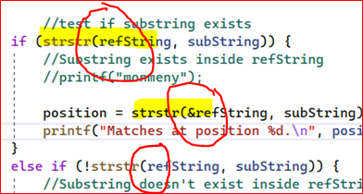
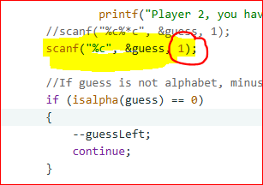
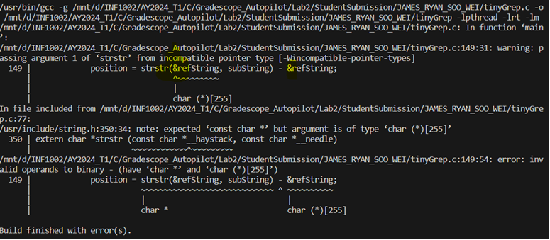
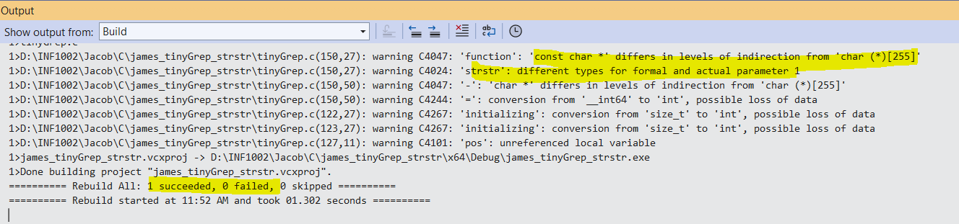
INF1002 – Programming Fundamentals
“scanf("%c", &guess, 1);”. This usage results in compiler warning/error as it has size parameter that is not supported.
Inconsistent usage of strstr() function
Compilation error with strstr() function in VS Code and Ubuntu-gcc
Compilation warnings and no errors with strstr() function in VS Community edition

Slide 13
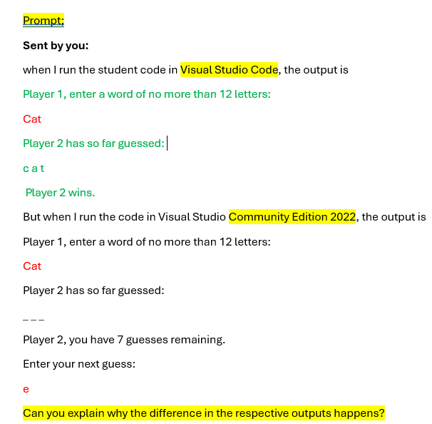
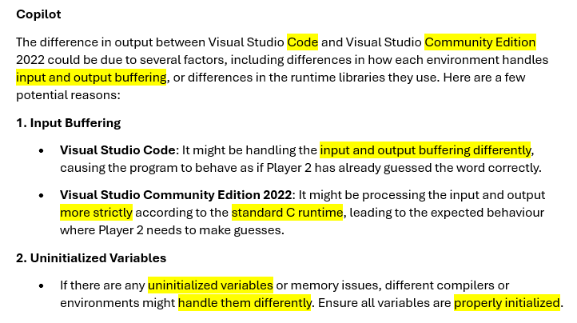
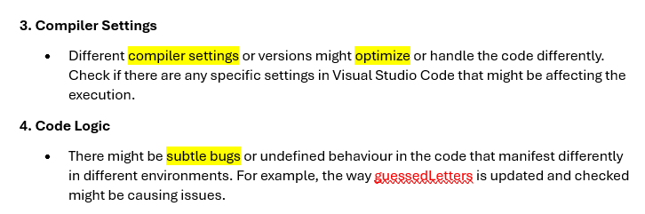
INF1002 – Programming Fundamentals

Slide 14
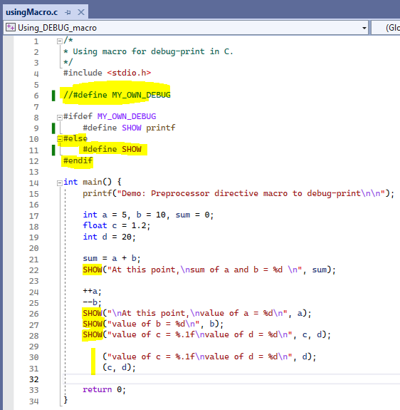
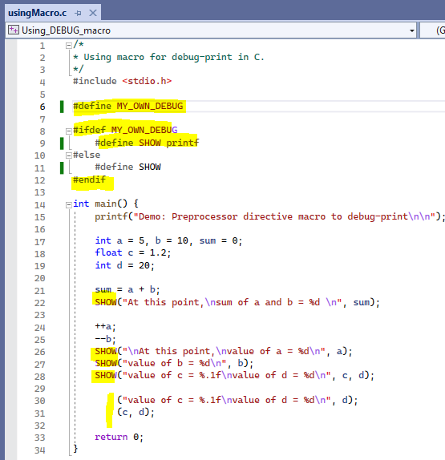


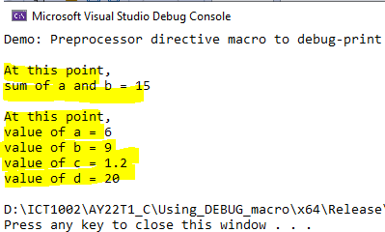
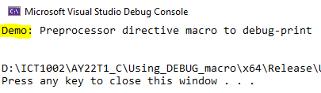
INF1002 – Programming Fundamentals
C Preprocessor macro for debug-print
1
1
DEBUG
1
1
2
2
Debug-print
No compiler error / warning

Slide 15
INF1002 – Programming Fundamentals
Instructions to submit and auto grade your code to Gradescope:
Download the skeleton code file “insertionSort.c” from the “C\Lab Assignments\Lab4” xSiTe folder.
Do not change file name or function names.
Add your code to the function “main()” and other required functions.
Don’t use sys.argv[] for user inputs. Use other functions such as scanf(), fgets(), fgetc(), etc.,
Drag and drop your locally tested code (insertionSort.c) to Gradescope. You can submit and auto graded any number of times. Last submission counts.
There are 5 test cases and maximum score for this task is 5.
Autograder will be timed out after 10 minutes.

Slide 16
INF1002 – Programming Fundamentals
Control measures in Gradescope:
Autograder time out: Execute each test case for 30 seconds maximum and limit output to 50 lines
Missing new lines (“\n”) in printf(): Normalized actual and expected outputs.
Extra white spaces: Normalized actual and expected outputs.
Case sensitiveness: Not normalized.
Show first mismatch, or all expected (Exp) and actual (Got) outputs: depending on tasks
Environment:
OS: Ubuntu 22.04, Compiler: gcc (GNU C Compiler), CPU:1, RAM: 1.5 GB
scanf() / scanf_s():
scanf_s is a secure version of scanf available in the Microsoft C Runtime Library, which includes additional parameters for buffer sizes to prevent buffer overflows.
scanf is the standard input function available in the C standard library, which works on all platforms, including Linux.
If need to ensure input safety, add additional checks in the code to validate the input size and format

Slide 17
INF1002 – Programming Fundamentals
For Gradescope issues, Screen shot Gradescope result page and email to:
jacob.abraham@singaporetech.edu.sg

Slide 18
INF1002 – Programming Fundamentals
C Lab Assignments
Week # | C Lab # | Lab Date | Gradescope Release | Gradescope Due
8 | 1 | Friday, October 24, 2025 | Friday, October 24, 2025 08:00 | Thursday, October 30, 2025 23:59
9 | 2 | Friday, October 31, 2025 | Friday, October 31, 2025 08:00 | Thursday, November 6, 2025 23:59
10 | 3 | Friday, November 7, 2025 | Friday, November 7, 2025 08:00 | Thursday, November 13, 2025 23:59
11 | 4 | Friday, November 14, 2025 | Friday, November 14, 2025 08:00 | Thursday, November 20, 2025 23:59
12 | 5 | Friday, November 21, 2025 | Friday, November 21, 2025 08:00 | Thursday, November 27, 2025 23:59

